Slide 1
Sponsored Programs Administration
Faculty Dashboard Update

Slide 2
Grant Data Review
Features
Tracking of grant progress from Pre-Award through Closeout
Daily updates of expenses charged to each grant subaccount
Access to vital administrative and project specific information

Slide 3
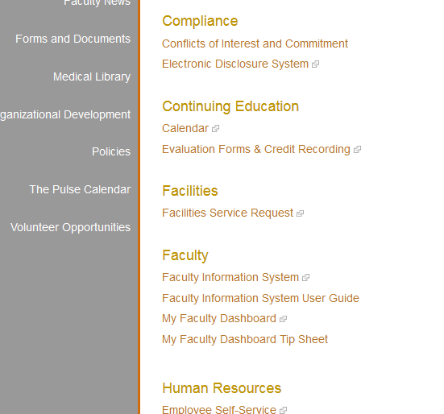
Access
WMed Portal
Automatically sign in to your dashboard
View only the grants for which you have been identified as an investigator

Slide 4
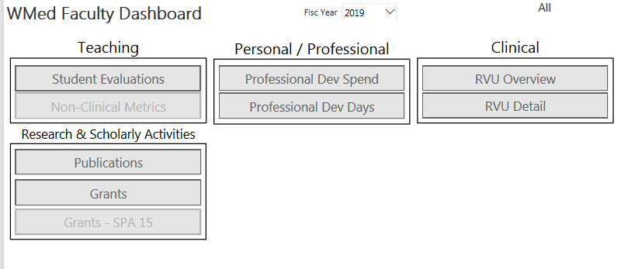
Access

Slide 5
Grant Progress

Slide 6
Grant Progress

Slide 7
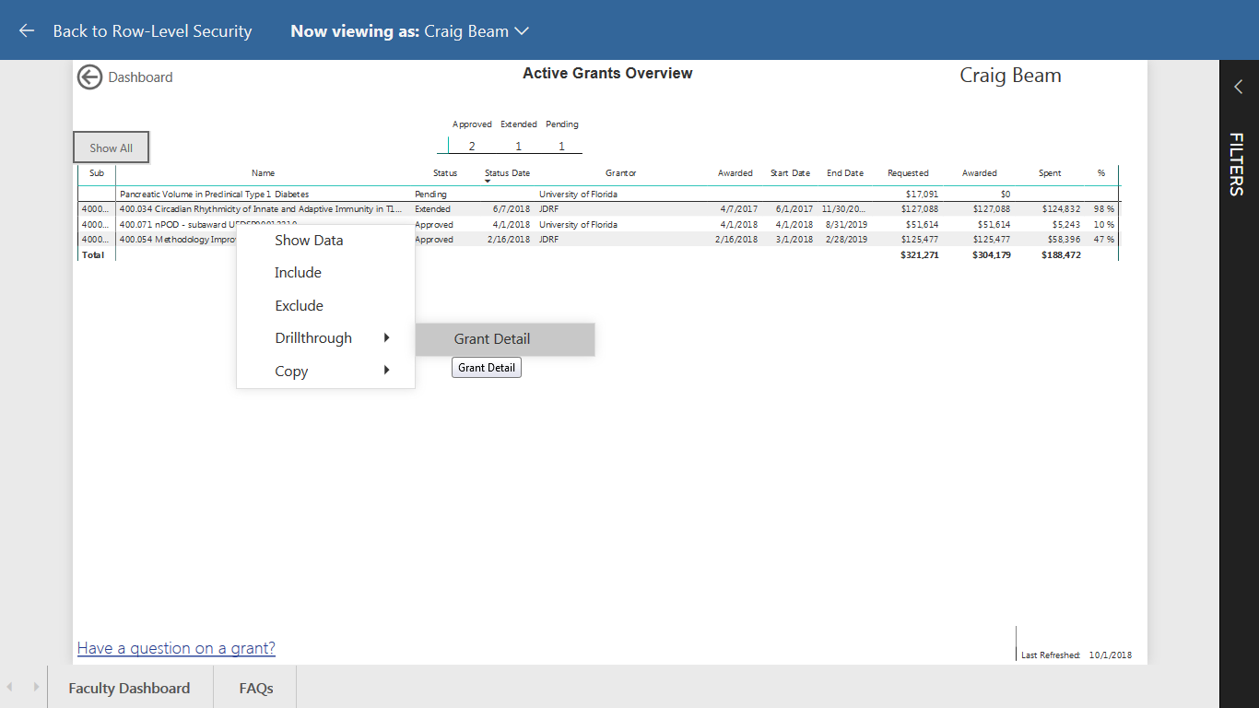
Grant Details
Right Click!

Slide 8
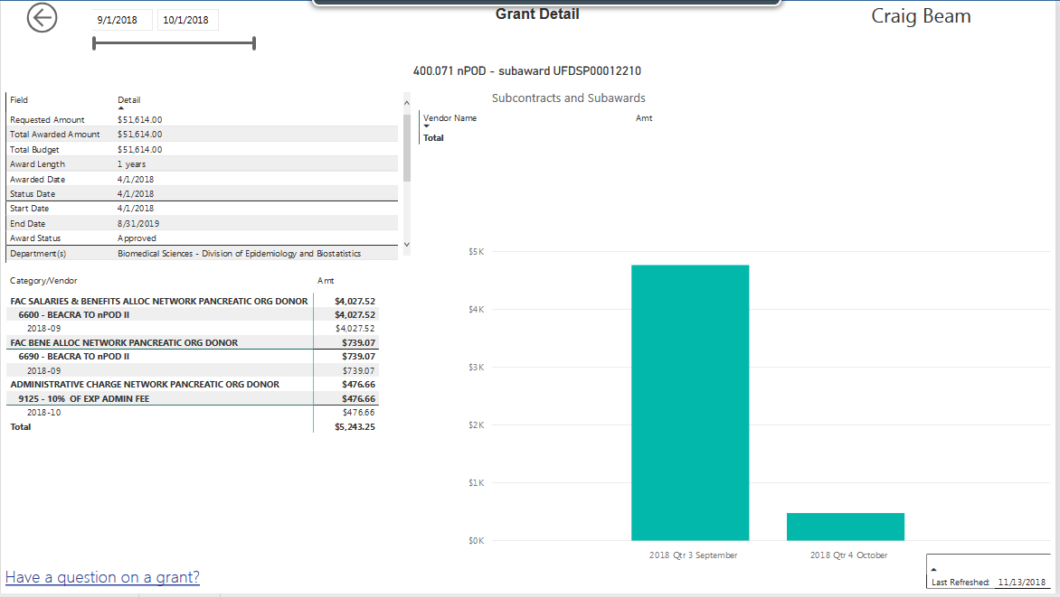
Grant Details

Slide 9
Contact Information
All grant related questions or issues contact:
Chris Schneider, MS
Director, SPA
Christopher.Schneider@med.wmich.edu
337-4268
Any problems accessing the dashboard, email: MyFacultyDashboard@med.wmich.edu

